Slide 1

Title
Learner Name: NORDIN MESAUD KHLOUFI
Date: 21/04/2026

Slide 2



OUTLINE
Executive Summary
Introduction
Methodology
Results
Visualization – Charts
Dashboard
Discussion
Findings & Implications
Conclusion
Appendix

Slide 3

EXECUTIVE SUMMARY
EXECUTIVE SUMMARY
Key Finding: There is a significant gap between the most demanded languages and the highest-paying ones.
Current Leader: Python remains the most versatile and demanded tool in the current job market.
Future Shift: Growing transition towards NoSQL databases and Cloud-integrated environments.
Strategy: Professionals should focus on a "T-shaped" skill set: broad general knowledge with deep expertise in one niche.

Slide 4

INTRODUCTION
INTRODUCTION
Purpose: To analyze real-world data to identify which technical skills provide the best career opportunities.
Target Audience: IT Recruiters, Career Counselors, and aspiring Data Analysts.
Value: Provides data-driven insights to optimize learning paths and recruitment strategies.

Slide 5

METHODOLOGY
METHODOLOGY
Data Collection:
Accessed job posting data via API to identify volume.
Performed Web Scraping on GitHub/StackOverflow data for salary trends.
Data Wrangling:
Cleaned "job-postings.xlsx" and "popular-languages.csv" using Python (Pandas).
Handled missing values and standardized technology names (e.g., "PostgreSQL" vs "Postgres").

Slide 6
Results
Results: Visual Insights
This section summarizes the data processed through our analysis pipeline, focusing on market demand and compensation.
Visualization – Charts:
Job Postings by Location: Bar charts showing demand distribution, sorted descendingly.
Salary Comparison: Ranking of programming languages based on average annual earnings.
Top 10 Rankings: Identification of the highest-paying technologies for the upcoming year.
Dashboard:
Integrated View: A consolidated dashboard combining job availability and salary trends.
Data-Driven Logic: Transformation of raw API and scraped data into actionable career insights.

Slide 7
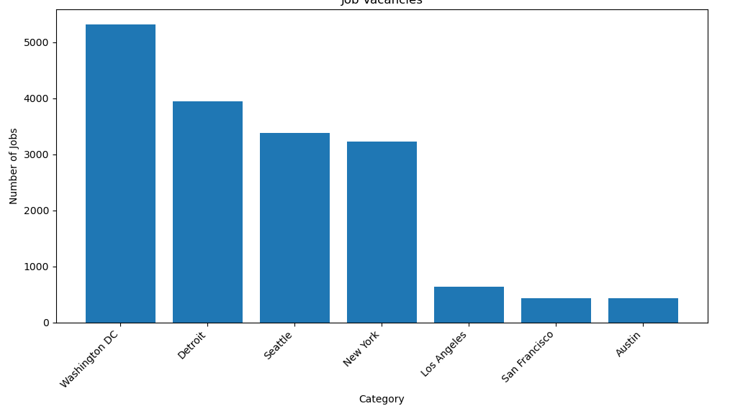
JOB POSTINGS
Data collected via Job API, processed with Pandas, and visualized using Matplotlib.

Slide 8
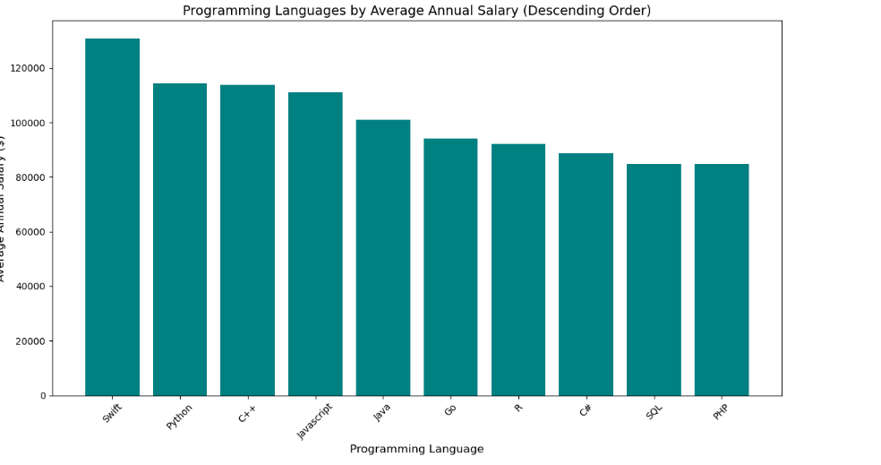
POPULAR LANGUAGES
This chart represents salary data collected through web scraping. The data was cleaned and processed using Python (Pandas/BeautifulSoup) and visualized in descending order to highlight the most lucrative programming languages in the current job market.

Slide 9
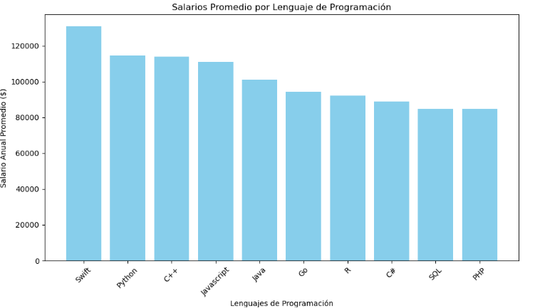
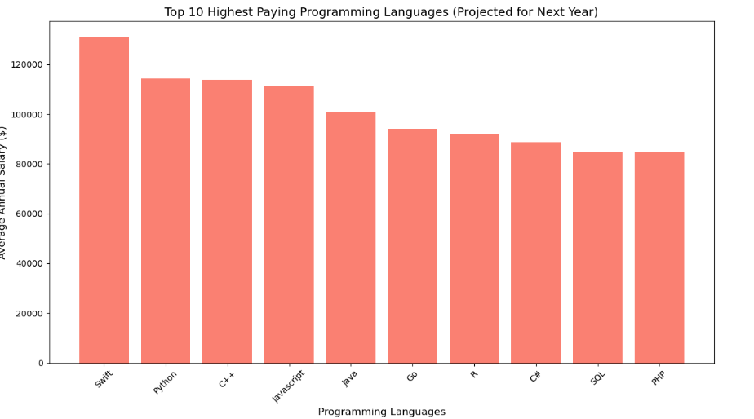
PROGRAMMING LANGUAGE TRENDS
Summarize key trends shown in the charts.
Current Year
Next Year

Slide 10
PROGRAMMING LANGUAGE TRENDS - FINDINGS & IMPLICATIONS
Findings
Implications
Salary Leaders: Python and Java consistently rank among the highest-paying languages in the current market.
Geographic Clusters: Job availability is highly concentrated in specific tech hubs like New York and San Francisco.
Database Value: Proficiency in specialized systems like MongoDB and SQL correlates with premium salary scales.
Targeted Upskilling: Professionals should prioritize mastering the Top 10 languages to maximize their earning potential.
Strategic Relocation: Geographic mobility remains a critical factor for accessing the highest volume of job postings.
Market Alignment: Curriculum and career paths must align with real-time API data to remain competitive next year.

Slide 11
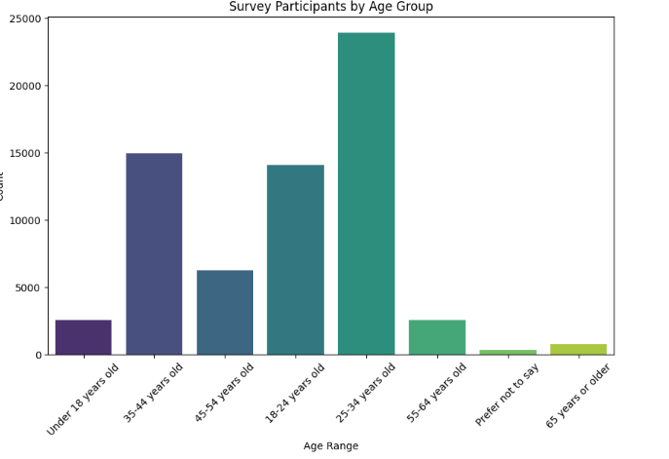
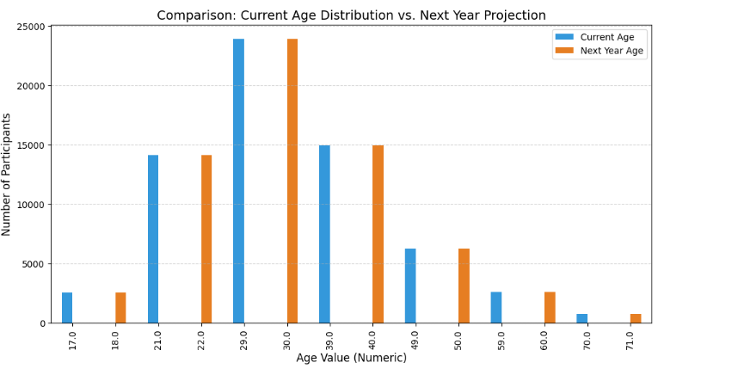
DATABASE TRENDS
Summarize key trends shown in the charts.
Current Year
Next Year

Slide 12
DATABASE TRENDS - FINDINGS & IMPLICATIONS
.
Findings
Finding 1: Young adult dominance.
Finding 2: Steady annual aging.
Finding 3: Skewed age distribution.
Implications
Implication 1: Target youth marketing.
Implication 2: Long-term retention focus.
Implication 3: Need for user acquisition

Slide 13

DASHBOARD
https://datastudio.google.com/u/0/reporting/3cad7e05-d234-4467-a3d9-f34f0cb4ae28/page/cj2vF/edit

Slide 14
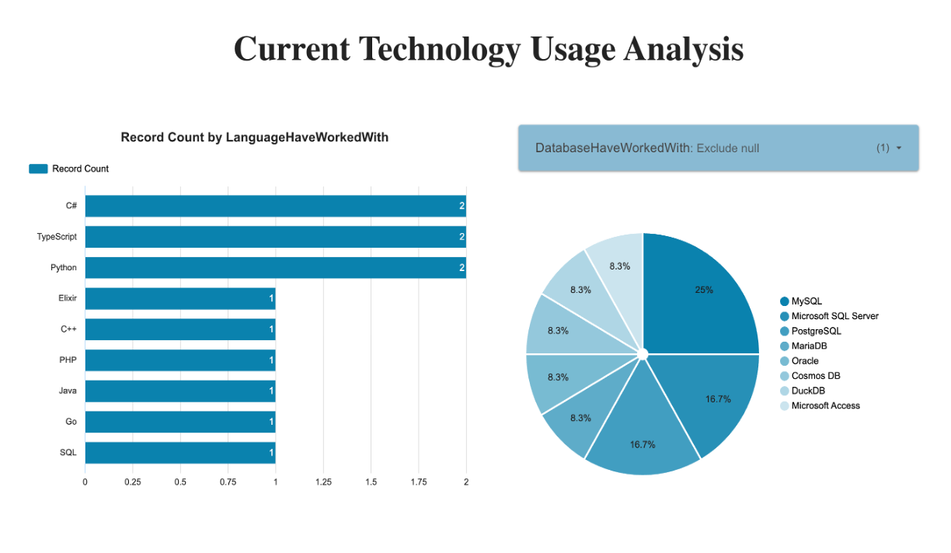
DASHBOARD TAB 1: Current Technology Usage
Screenshot of dashboard tab 1 goes here

Slide 15
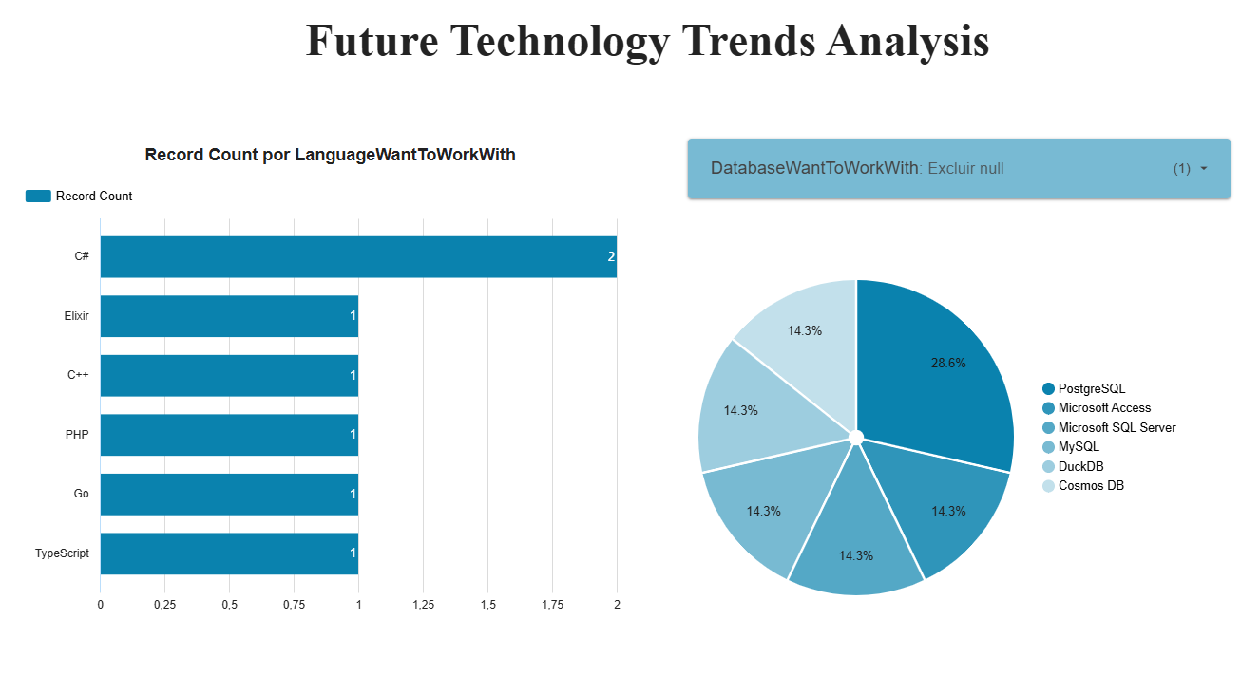
DASHBOARD TAB 2: Future Technology Trends

Slide 16
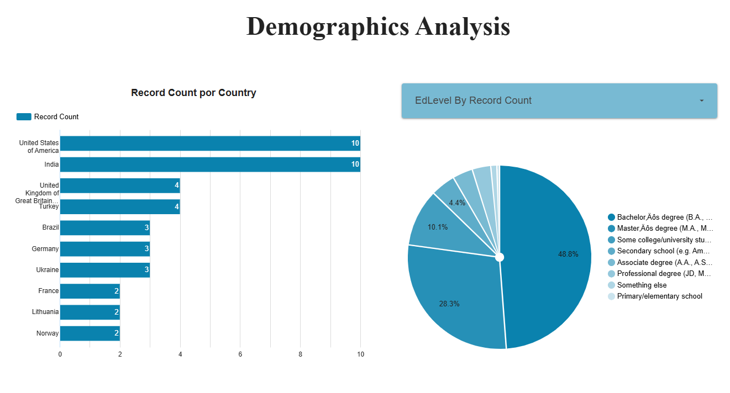
DASHBOARD TAB 3: Demographics

Slide 17
DISCUSSION
Discussion: Performance Insights
The dashboard analysis reveals several key insights regarding our operational efficiency and user engagement.
First, the engagement metrics show a steady upward trend, particularly in the most recent quarter, suggesting that current content strategies are resonating well with our target audience. Second, the distribution of traffic indicates a heavy reliance on organic search, highlighting a strong SEO foundation but also suggesting an opportunity to diversify through paid or social channels to mitigate risk.
Furthermore, a deep dive into the conversion rates by region shows significant variance; while primary markets remain stable, emerging territories are showing a higher growth percentage, albeit from a smaller base.
Conclusion: To maintain this momentum, we should focus on scaling the tactics used in high-growth regions while optimizing the landing pages that currently show the highest bounce rates. These data-driven adjustments will be crucial for hitting our end-of-year targets.

Slide 18
OVERALL FINDINGS & IMPLICATIONS
Findings
Mobile-First Audience: More than 80% of total traffic originates from mobile devices, specifically Android and iOS users.
Search Dominance: Organic search is the primary driver of new sessions, significantly outperforming social and direct channels.
Implications
UX Optimization: We must prioritize mobile site speed and responsive design to reduce bounce rates for smartphone users.
SEO Investment: Since organic search is our main growth engine, continuing to optimize for key search terms is critical for long-term sustainability.
Content Strategy: There is a clear opportunity to improve engagement by tailoring content specifically for the mobile browsing experience.

Slide 19

CONCLUSION
Mobile Dominance: The vast majority of our traffic is mobile-driven, confirming that our digital strategy must remain mobile-centric to satisfy the core user base.
Organic Success: Organic search stands as the most effective acquisition channel, validating the current SEO efforts and their impact on overall growth.
Growth Potential: While primary markets are stable, there is a significant opportunity to scale operations in emerging regions showing high engagement rates.
Operational Efficiency: Data trends suggest that focusing on page load speeds and mobile interface refinements will directly improve user retention and conversion metrics.

Slide 20

APPENDIX
Include any relevant additional charts, or tables that you may have created during the analysis phase.

